Slide 1



Conserving evolutionary processes
Jeffrey Hanson
jeffrey.hanson@uqconnect.edu.au
jeffrey-hanson.com

Slide 2


Acknowledgements
Richard Fuller
Jonathan Rhodes
Cynthia Riginos
Hugh Possingham
Stuart Butchart
Graeme Buchanan
Carlo Rondinini
Francesco Ficetola

Slide 3
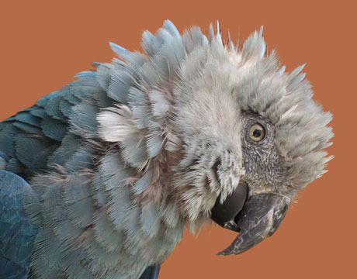
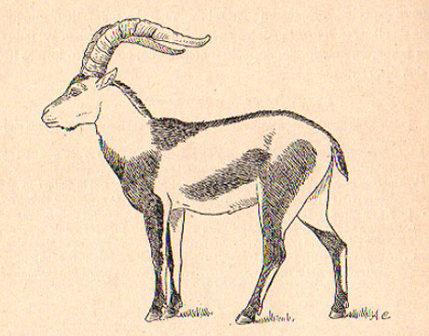
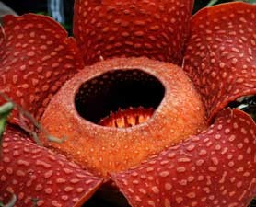
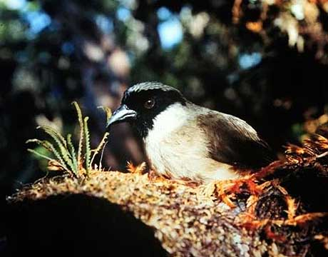
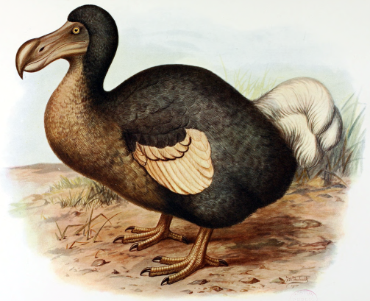
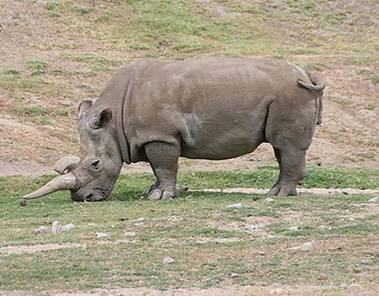
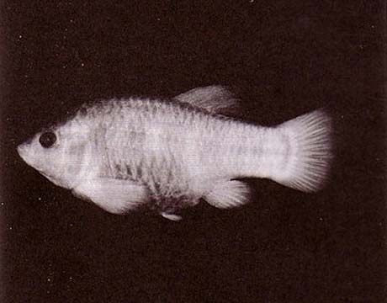
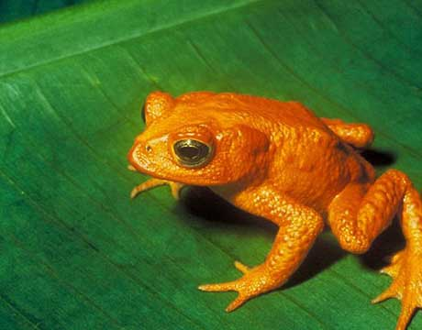
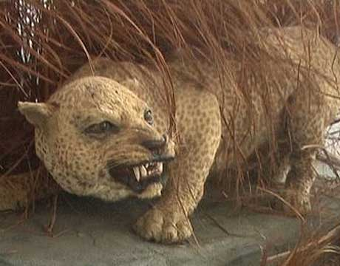
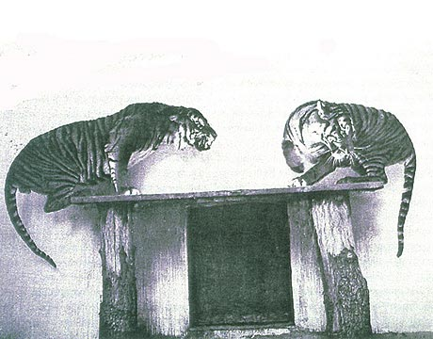
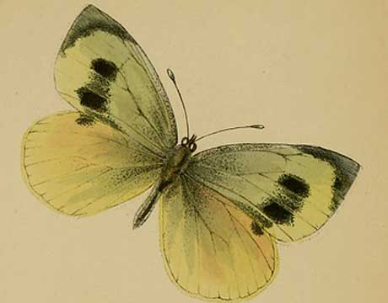
Global biodiversity crisis
Notes:
- high extinction rate
- conservation aims to maintain existing patterns of biodiversity and the processes that sustain them
- areas set aside to preserve biodiversity, and spearhead direct management actions

Slide 4
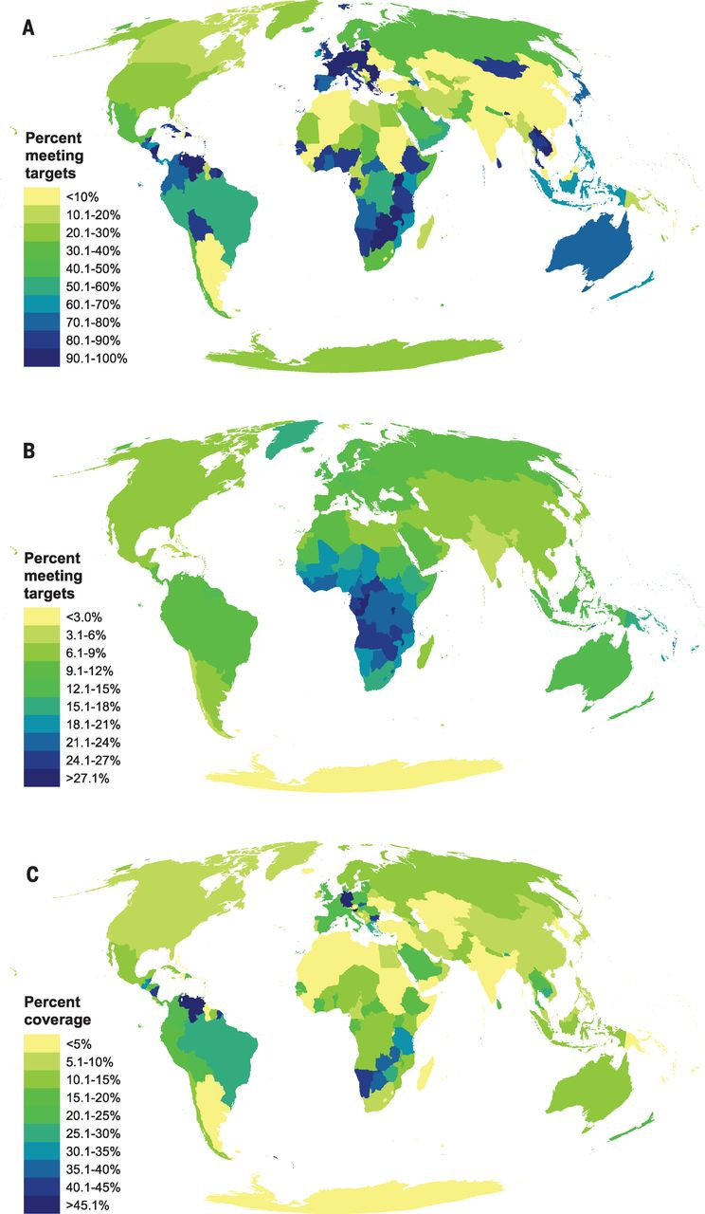
Protected areas
Runge et al. (2015) Science, 350: 1255-1258.

Slide 5
Protected areas
Runge et al. (2015) Science, 350: 1255-1258.

Slide 6
Reserve Selection
Notes:
- not all remaining habitat can be preserved
- achieve conservation objectives for minimal cost
- modern systematic conservation planning primarily focusses on representing species
- however, this ignores intra-specific biodiversity

Slide 7
Reserve Selection

Slide 8
Reserve Selection

Slide 9
Reserve Selection

Slide 10

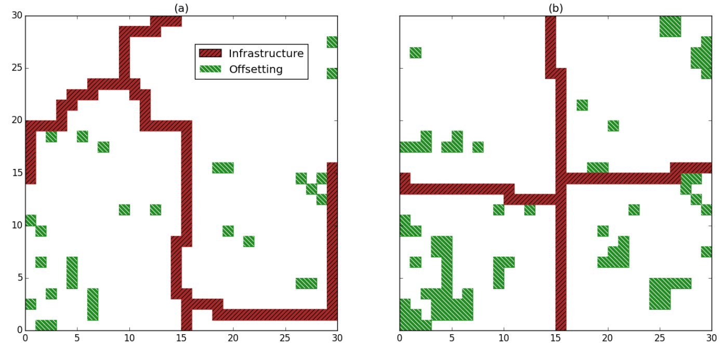
Reserve selection
Infrastructure
Bunton et al. (2015) 21st MODSIM, 1427-1433

Slide 11
Reserve selection
Infrastructure
Biodiversity
Bunton et al. (2015) 21st MODSIM, 1427-1433

Slide 12
Evolutionary processes
Species range
Population

Slide 13
Evolutionary processes
Species range
Population

Slide 14
Evolutionary processes
Species range
Population

Slide 15
Evolutionary processes
Species range
Population

Slide 16

raptr: representative and adequate prioritization toolkit in r
Create a general reserve selection method to identify adequate and representative networks
Compare solutions generated to conventional reserve selection methods
Hanson et al. (2017) Methods in Ecology & Evolution, Accepted.

Slide 17
Sampling a continuous space
A
B
C
Temperature (°C)
D
Rainfall (mm)

Slide 18
Sampling a continuous space
A
Amount target = 75 %
B
C
Temperature (°C)
D
Space sampled = POOR
Rainfall (mm)

Slide 19
Sampling a continuous space
A
Amount target = 75 %
B
C
Temperature (°C)
D
Space target = GOOD
Rainfall (mm)

Slide 20
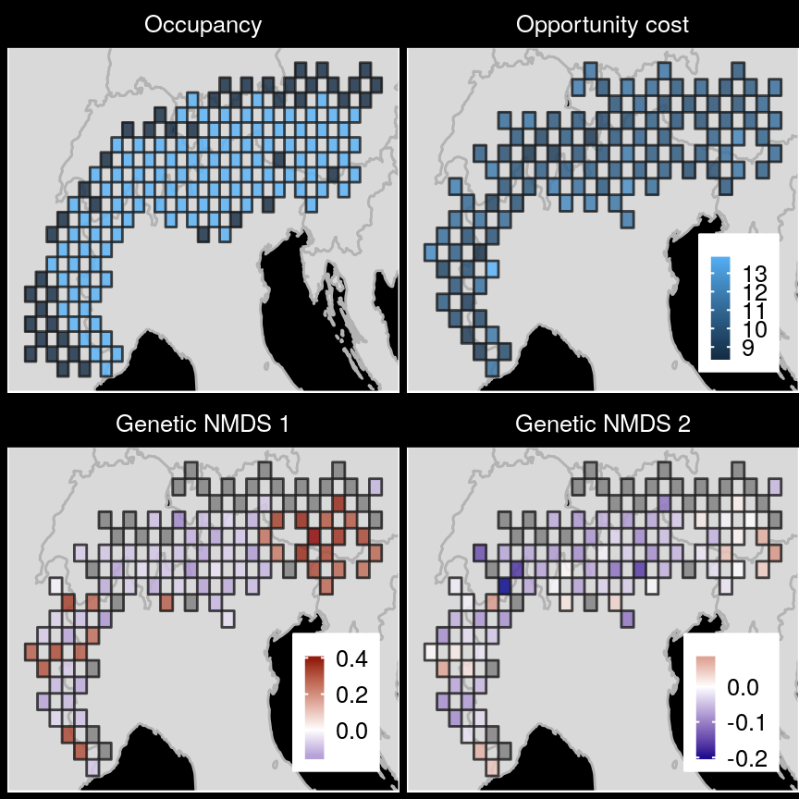
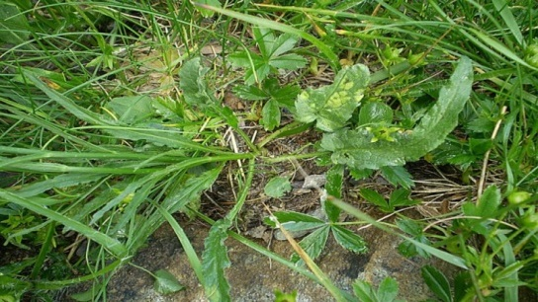
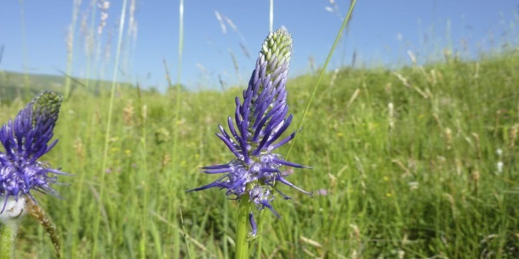
Case study
betony leaved rampion

Slide 21
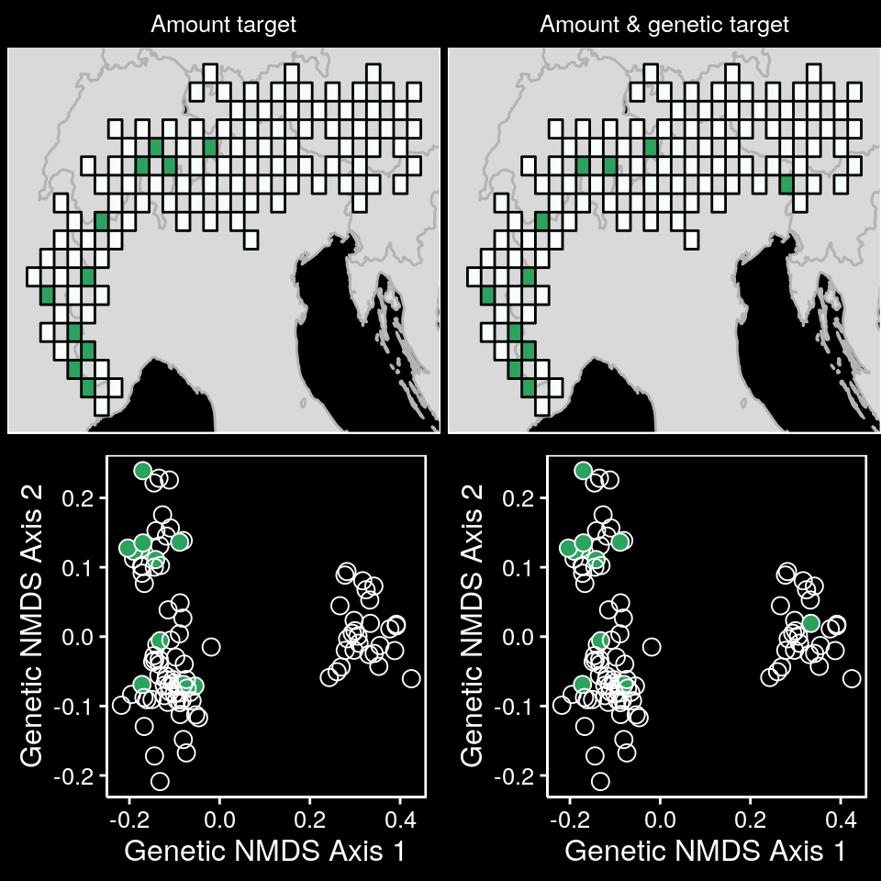
Case study

Slide 22
Case study

Slide 23
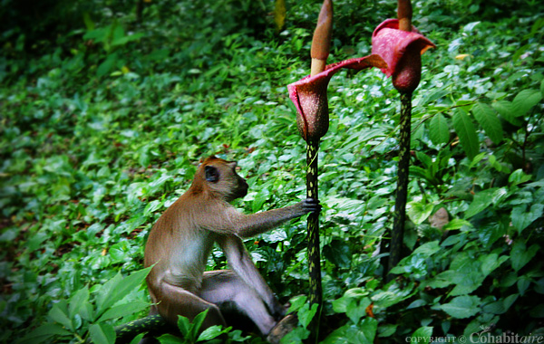

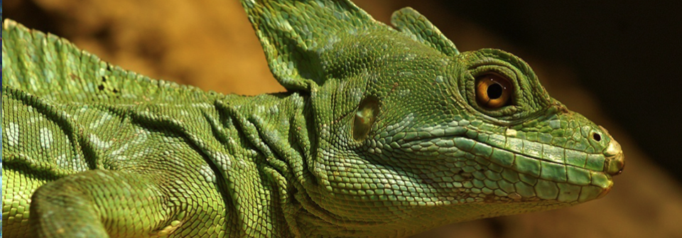
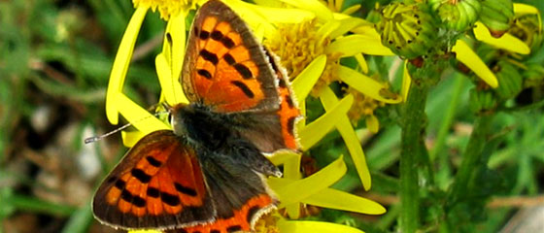
General reserve selection problem
new method to secure biodiversity patterns & processes
package on CRAN
applied to any system
more effective solutions

Slide 24
Environmental and geographic variables are effective surrogates for conservation planning
Hanson et al. (2017) Under review.

Slide 25
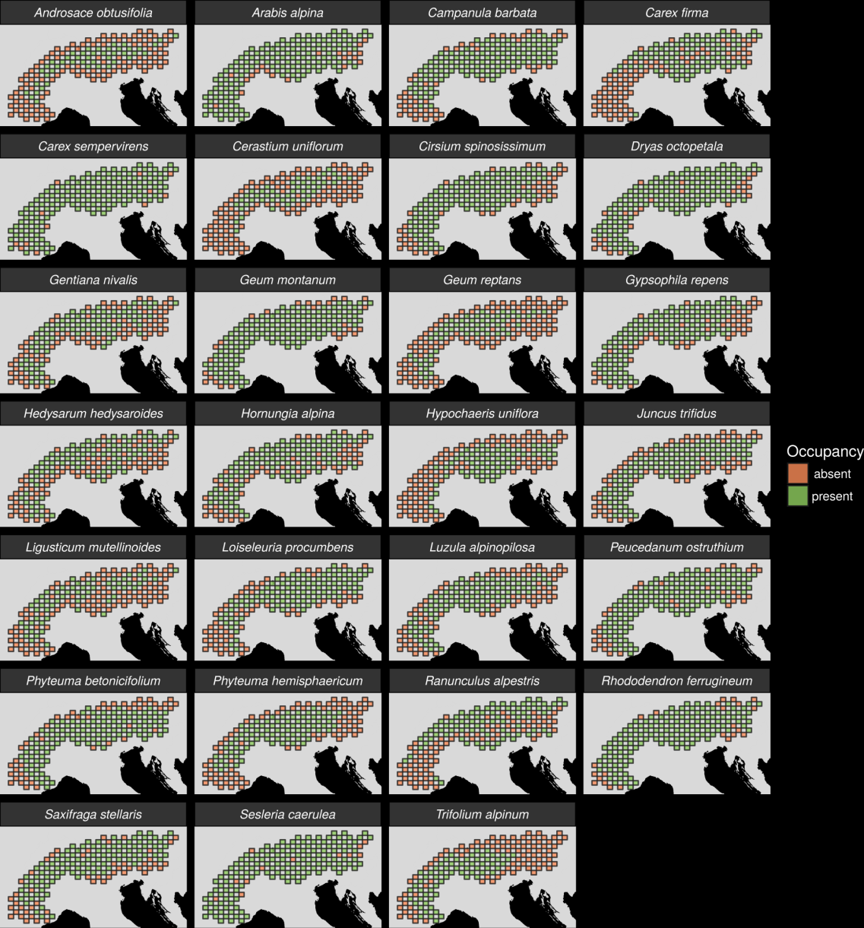
27 plant species
Different dispersal modes
Different life-histories
Different niches

Slide 26
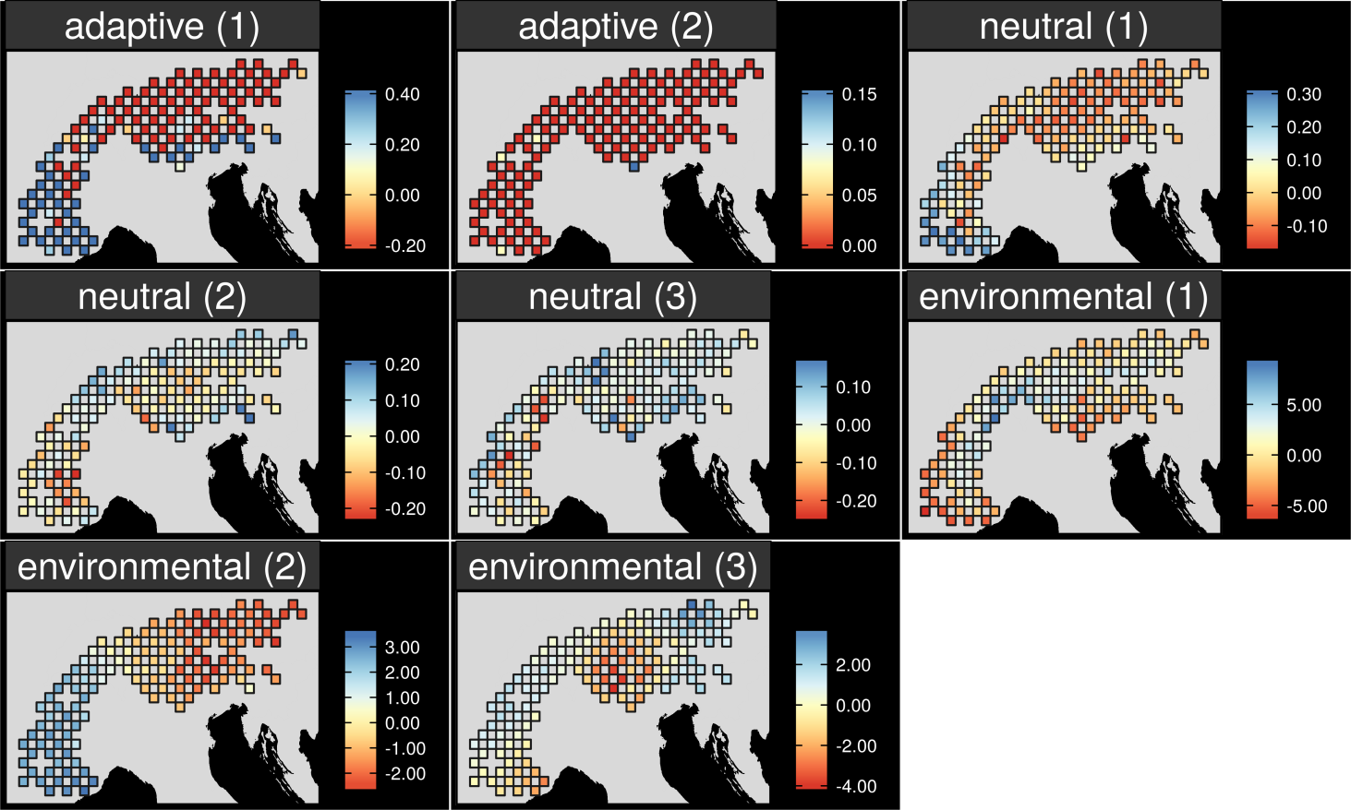
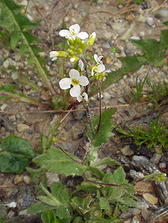
Map intra-specific genetic variation
Arabis alpina

Slide 27
Map intra-specific genetic variation
Arabis alpina

Slide 28
Map intra-specific genetic variation
Arabis alpina

Slide 29
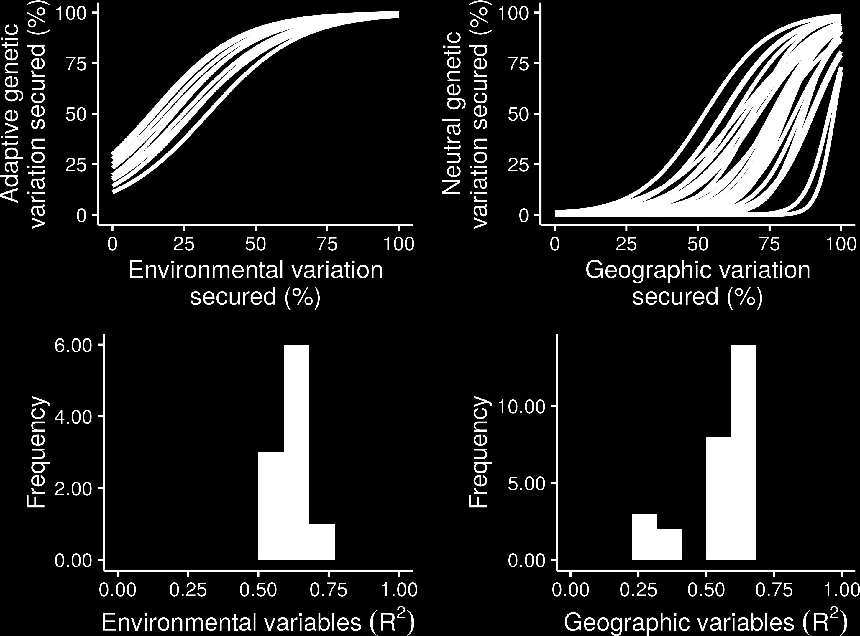
What is the relationship?

Slide 30
What is the relationship?

Slide 31
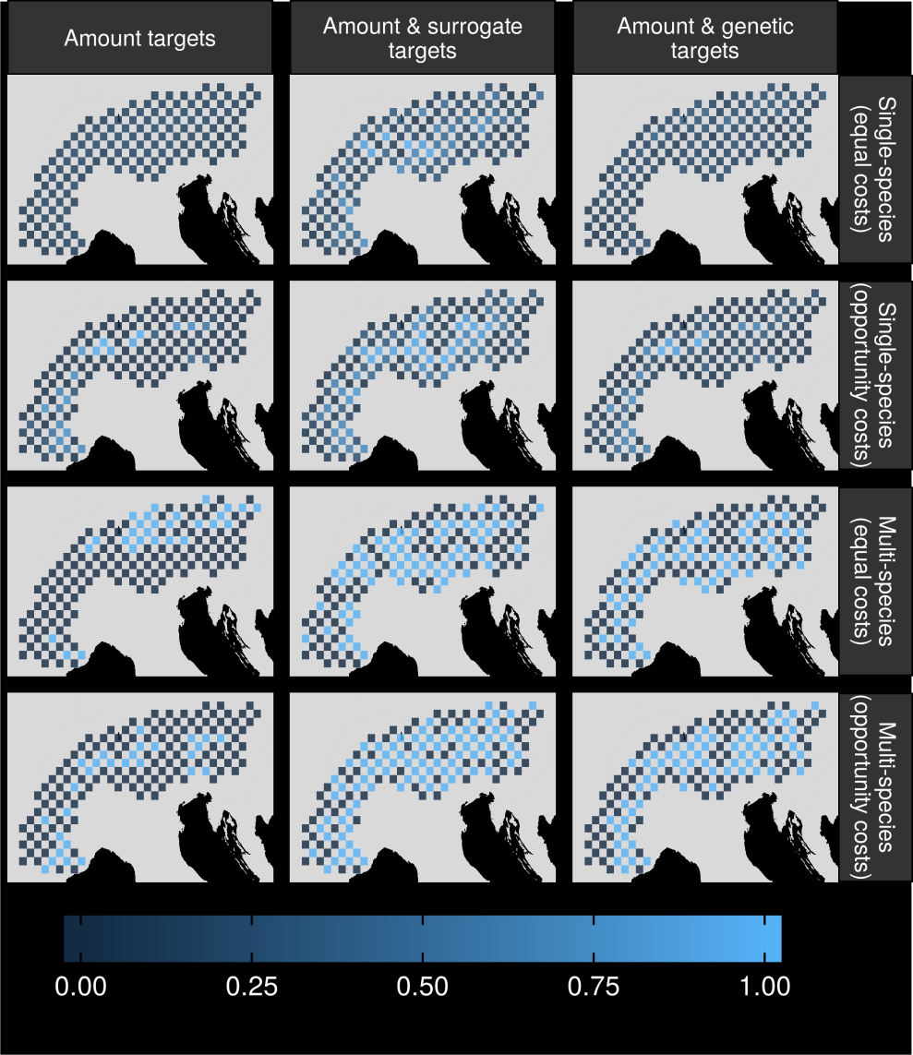
Can we make better decisions using surrogates?

Slide 32
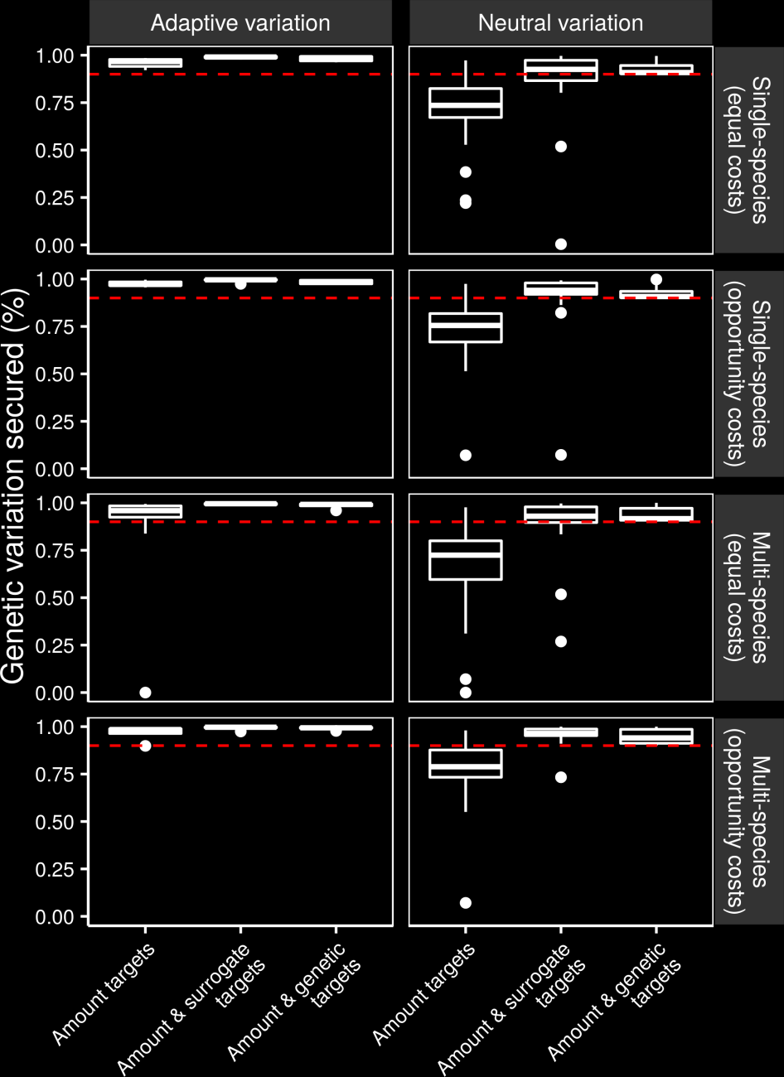
Can we make better decisions using surrogates?

Slide 33
Can we make better decisions using surrogates?

Slide 34
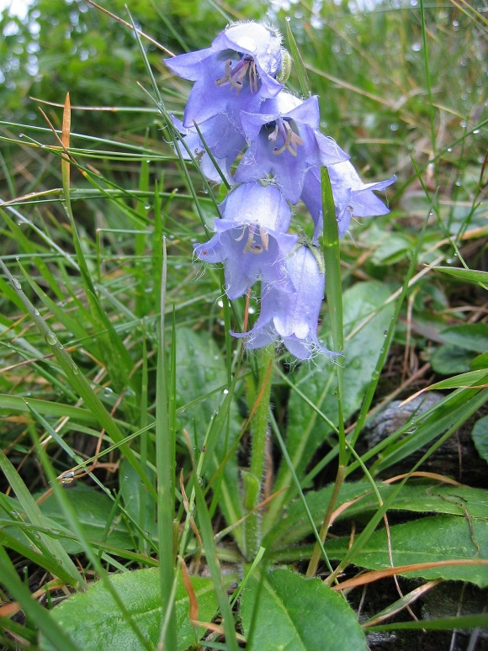
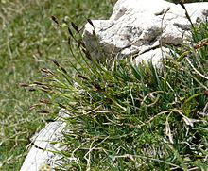
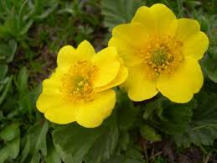
Surrogate performance
Effective for most species
Conventional methods may capture adaptive variation
Performance of geographic distances may depend on dispersal mechanisms

Slide 35
Global conservation of realized niches
How well are species’ realized niches conserved in protected areas?
Which places offer the greatest conservation benefit?
Hanson et al. (2017) In prep.

Slide 36
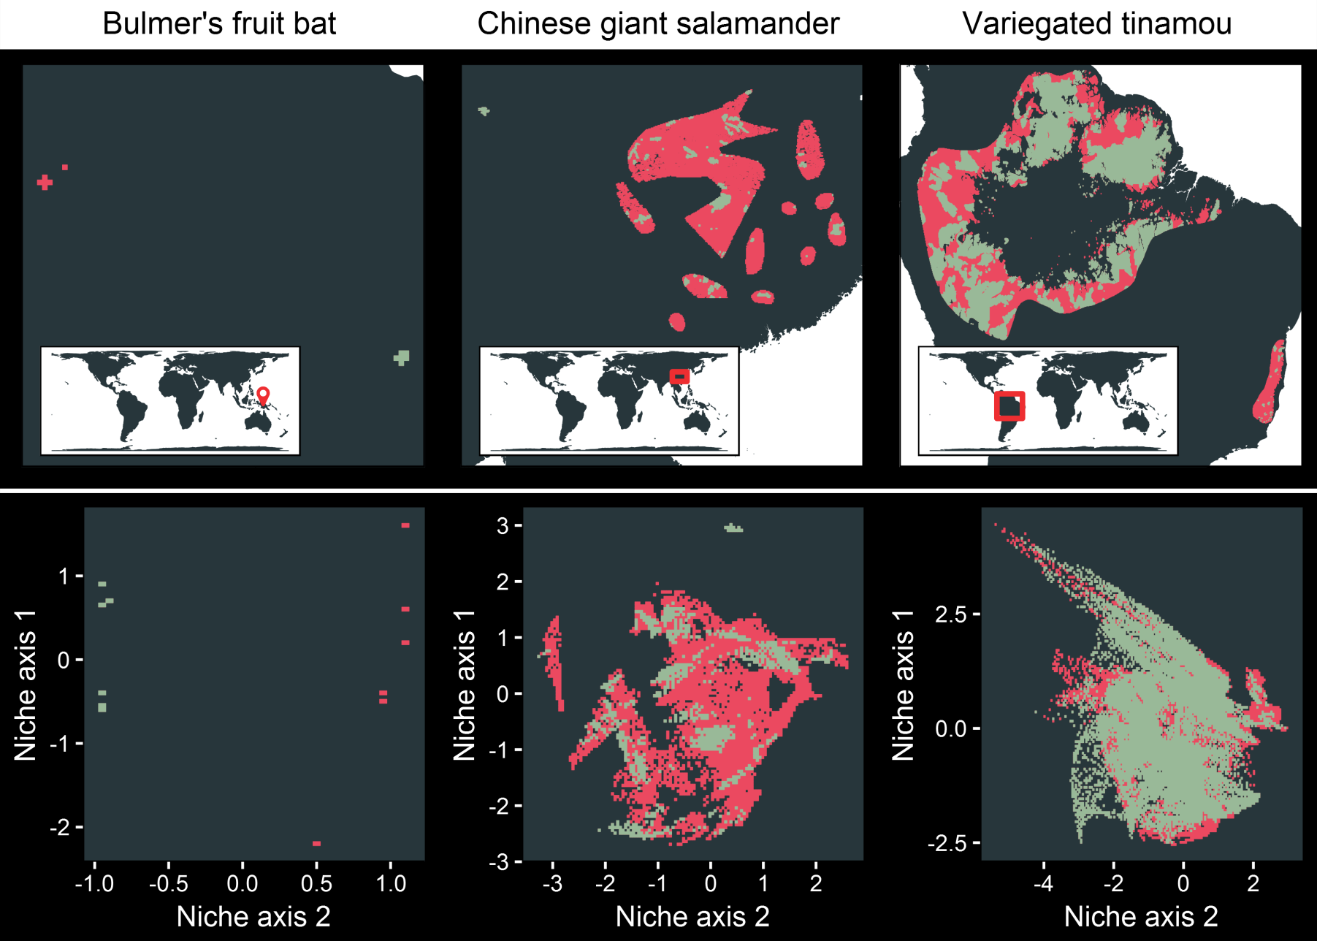
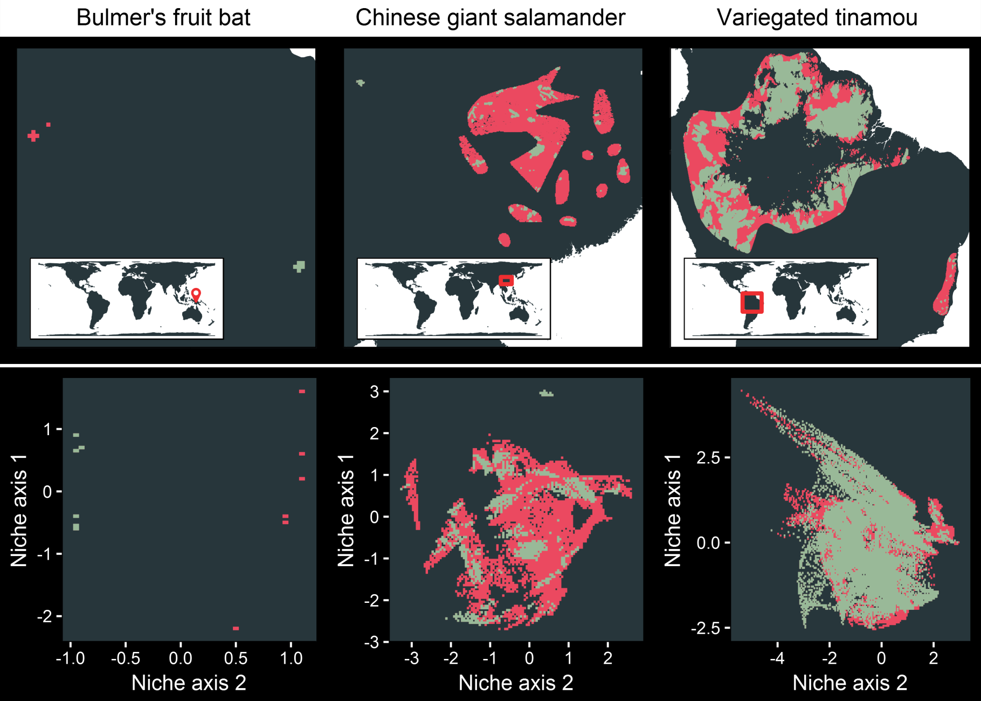
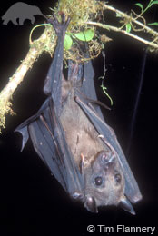
Niche representation metrics
Bulmer’s fruit bat
Geographic space
Niche space
Niche variation
sampled = 0.01 %
Niche volume
protected = 53 %

Slide 37
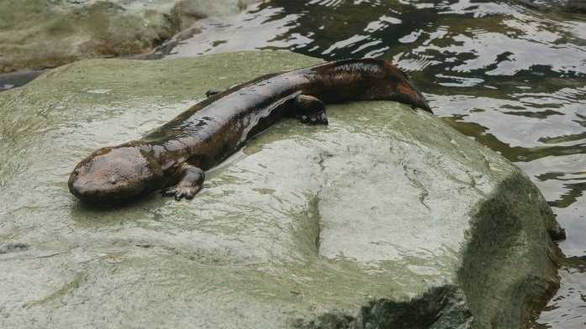
Niche representation metrics
Chinese giant salamander
Geographic space
Niche space
Niche variation
sampled = 98.22 %
Niche volume
protected = 14.01 %

Slide 38
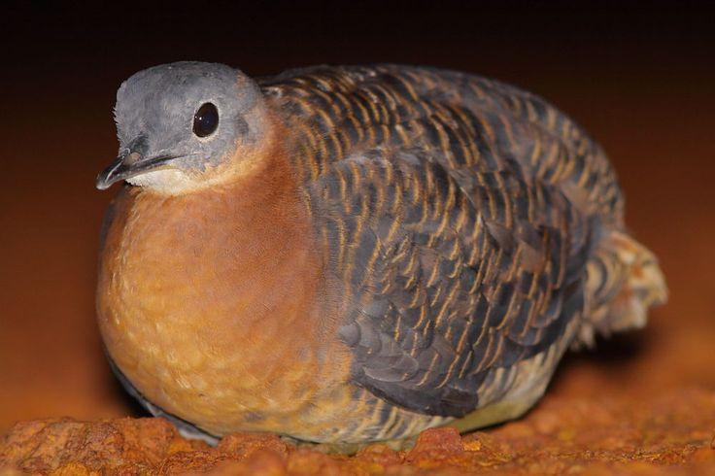
Niche representation metrics
Variegated
tinamou
Geographic space
Niche space
Niche variation
sampled = 98.22 %
Niche volume
protected = 14.01 %

Slide 39
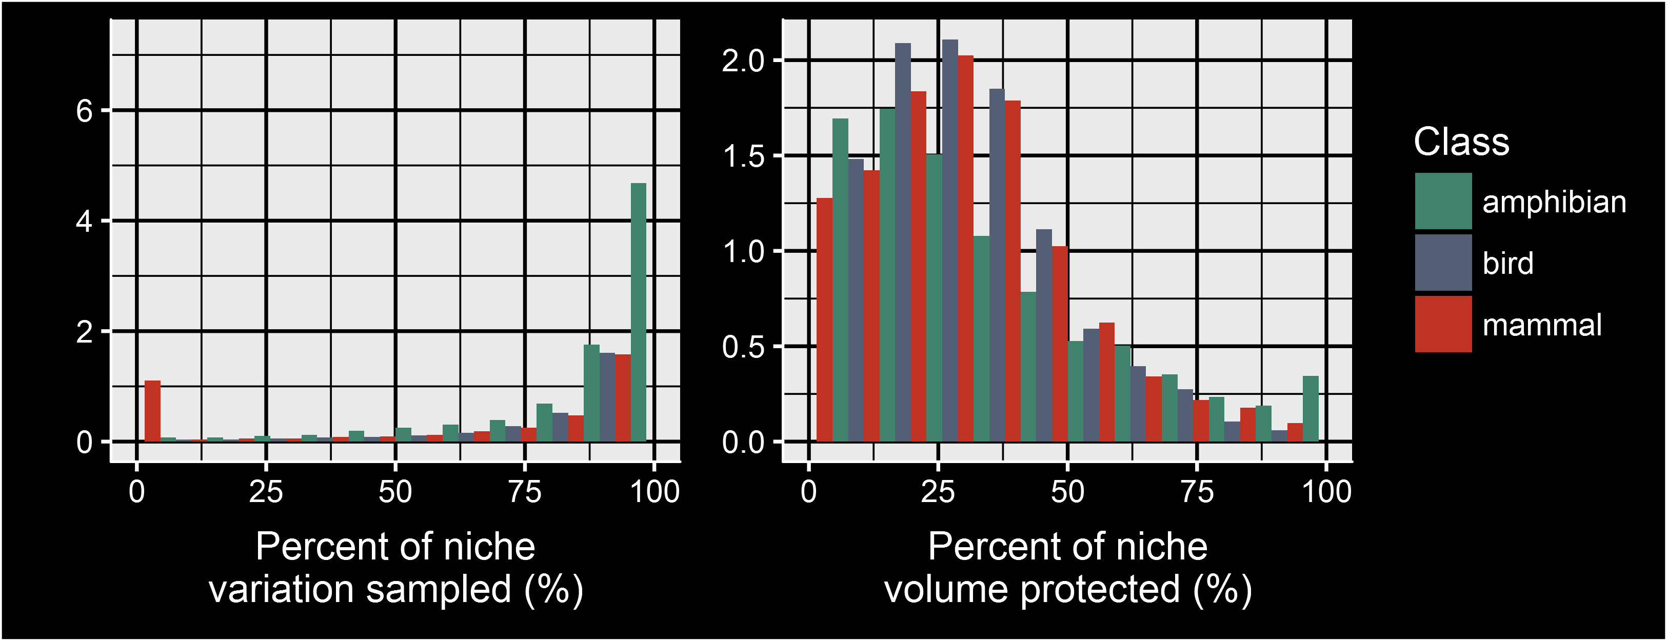
Global niche representation

Slide 40
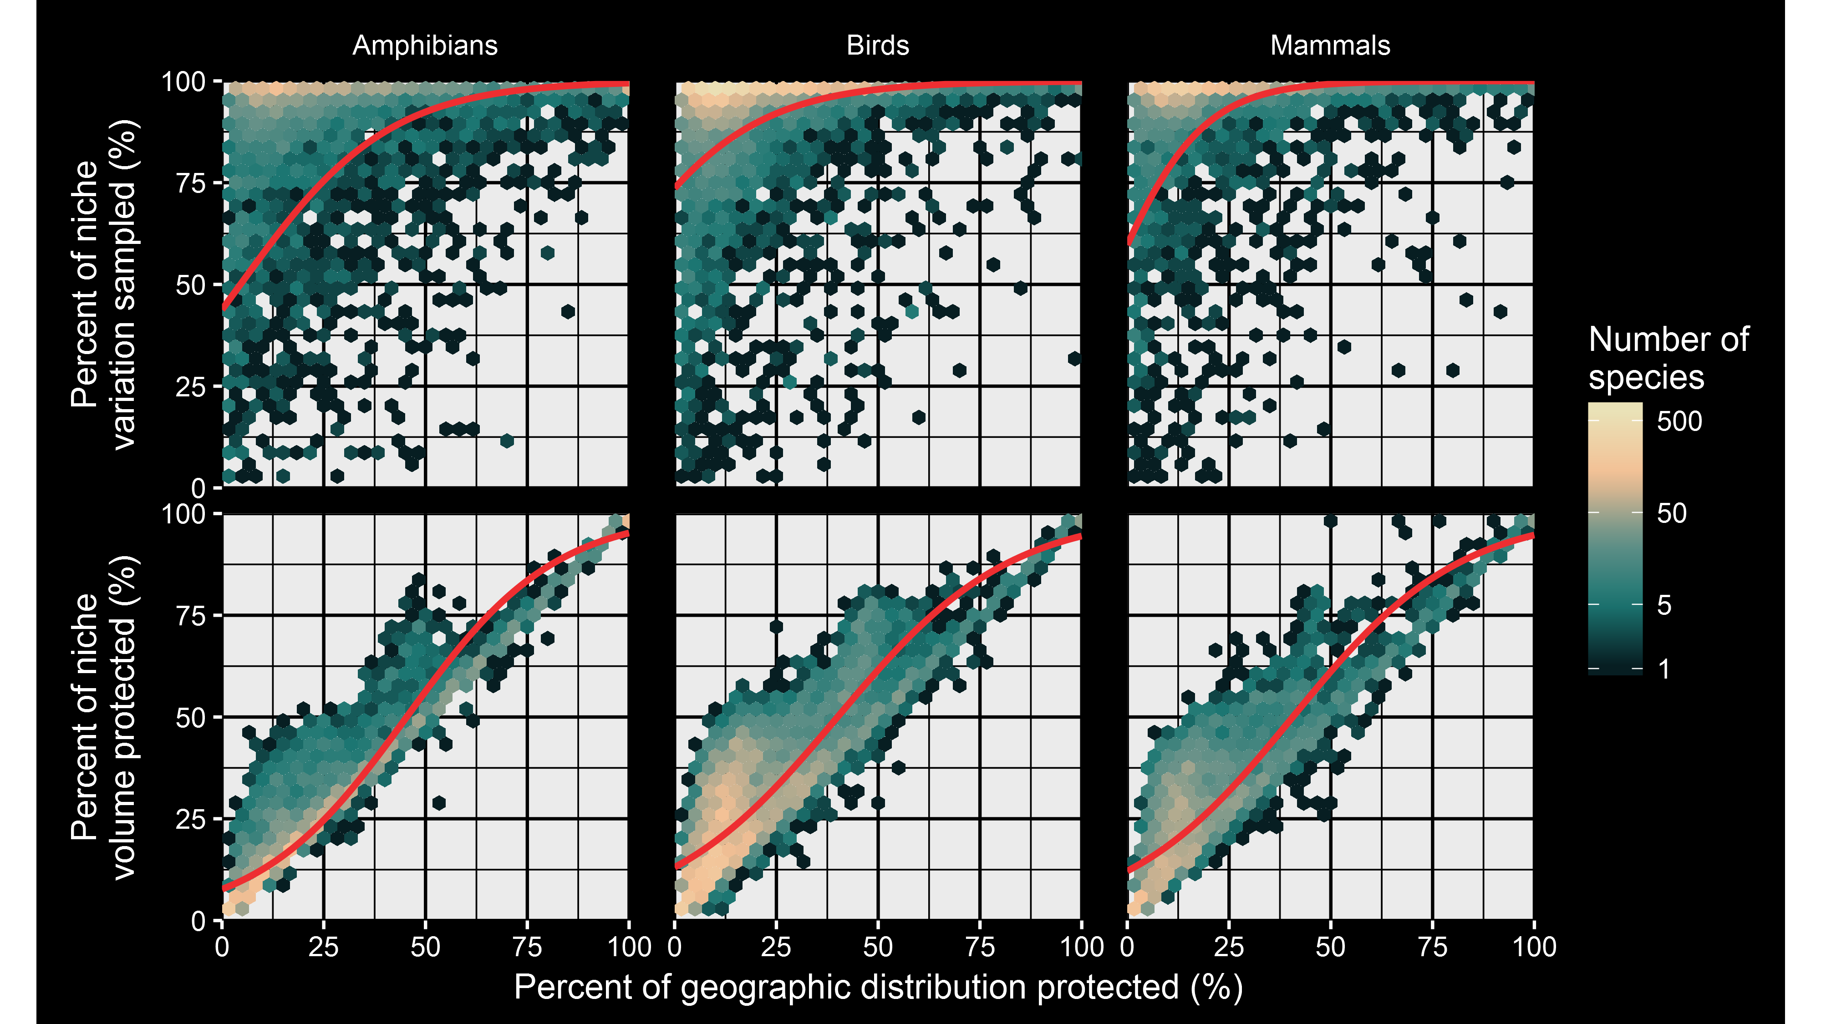

Slide 41
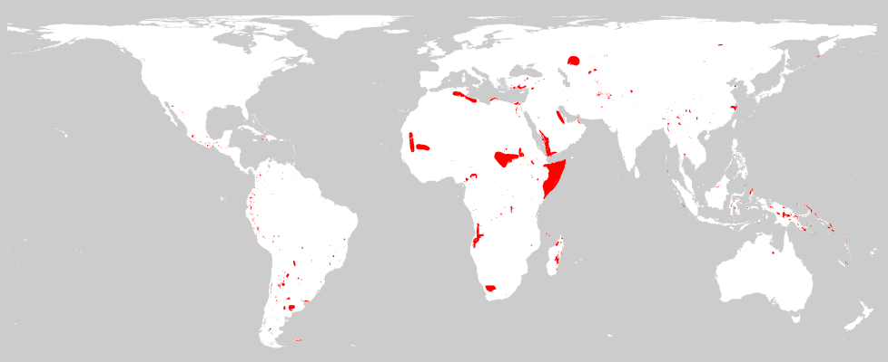
Species missing from protected areas

Slide 42
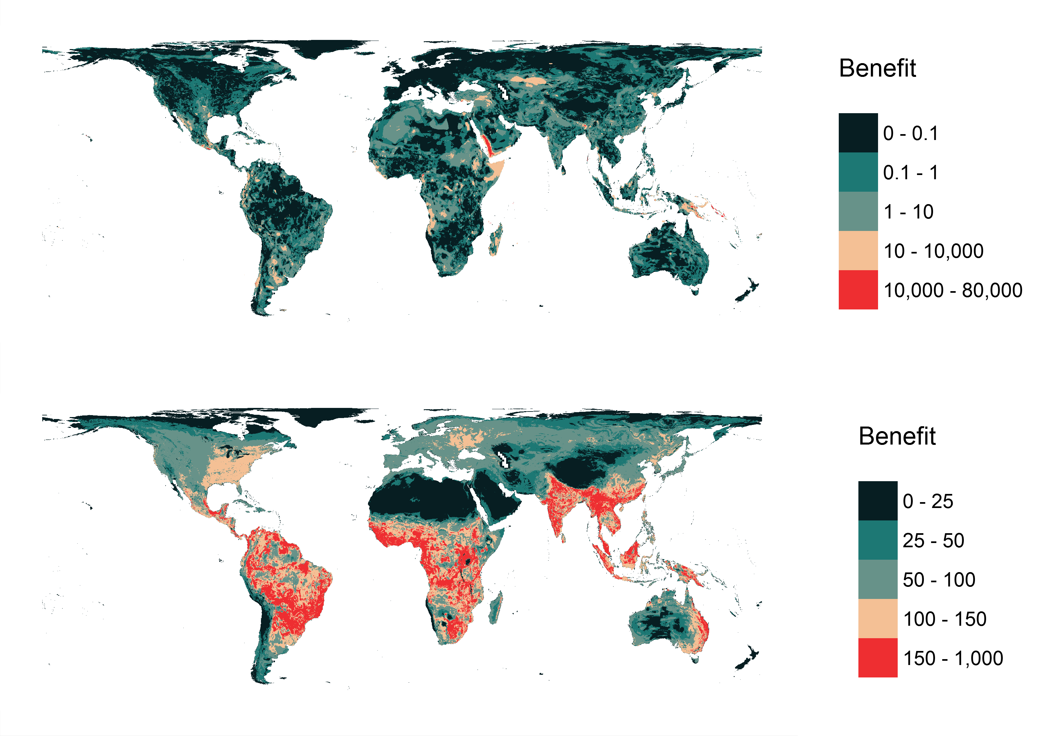
Niche variation benefit

Slide 43
Niche volume benefit

Slide 44
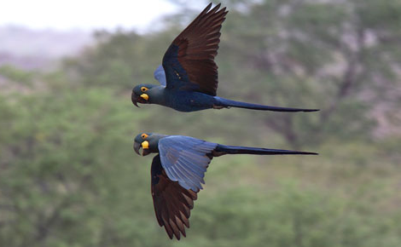
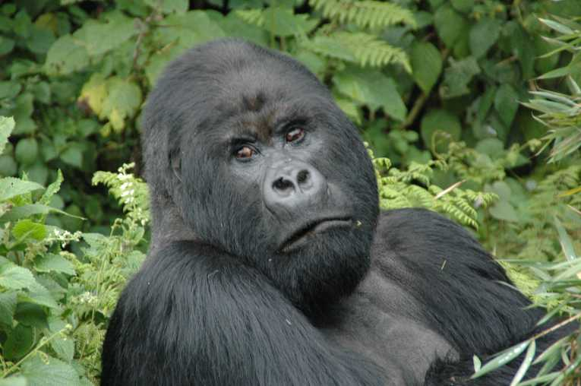
Global conservation of niches
Geographic measures alone aren’t good enough
Protected areas tend to be scattered across species’ niches

Slide 45
Take home messages
If you really want it: you need to plan for it
Surrogates may work – but no guarantees
Plug the gaps!

Slide 46



jeffrey.hanson@uqconnect.edu.au
www.github/jeffreyhanson
jeffrey-hanson.com

Slide 47


Is habitat suitability an effective surrogate for gene flow in conservation planning?
Preliminary results

Slide 48
Landscape resistance
Dudaniec et al. (2016) Molecular Ecology, 25: 470-486.

Slide 49
Reserve selection
Habitat suitability
Dispersible habitat
Solution

Slide 50
Reserve selection
Habitat suitability
Surrogate
Solution

Slide 51
Solution performance
Genetic-based solution
Surrogate-based solution

Slide 52
Solution performance
Genetic-based solution
Dispersible habitat
Surrogate-based solution
Maximum 8 units of
connected habitat
Maximum 5 units of
connected habitat

Slide 53
Data
12 gravity and animal-assisted dispersing species

Slide 54
Calibration

Slide 55
Effective for some species?

Slide 56
Habitat as a surrogate for gene flow
Might work for some species
Complicated by dispersal mechanisms
Incorporate species-specific connectivity into prioritizations

